Slide 1
Fundamentals of Algorithms
Objective 1

Slide 2
What is an algorithm?
Algorithms are a set of step-by-step instructions to perform a task
They are similar to recipes in cookbooks or engineering plans
Input – ingredients
Process – recipe
Output – dish
Uses of algorithms:
PageRank (Google search)
Weather forecasting
Why are algorithms good?
Fast
Automated

Slide 3
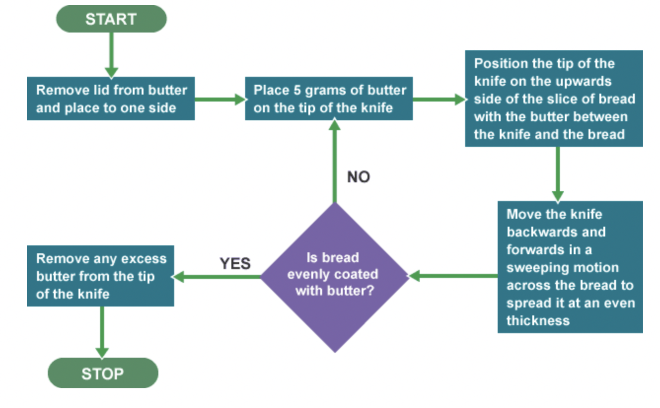
Designing an algorithm
Programs can be an algorithm or a set of algorithms
Design an algorithm in flowchart format
Algorithms have values called variables that get saved to memory
Convert the flowchart into variables

Slide 4
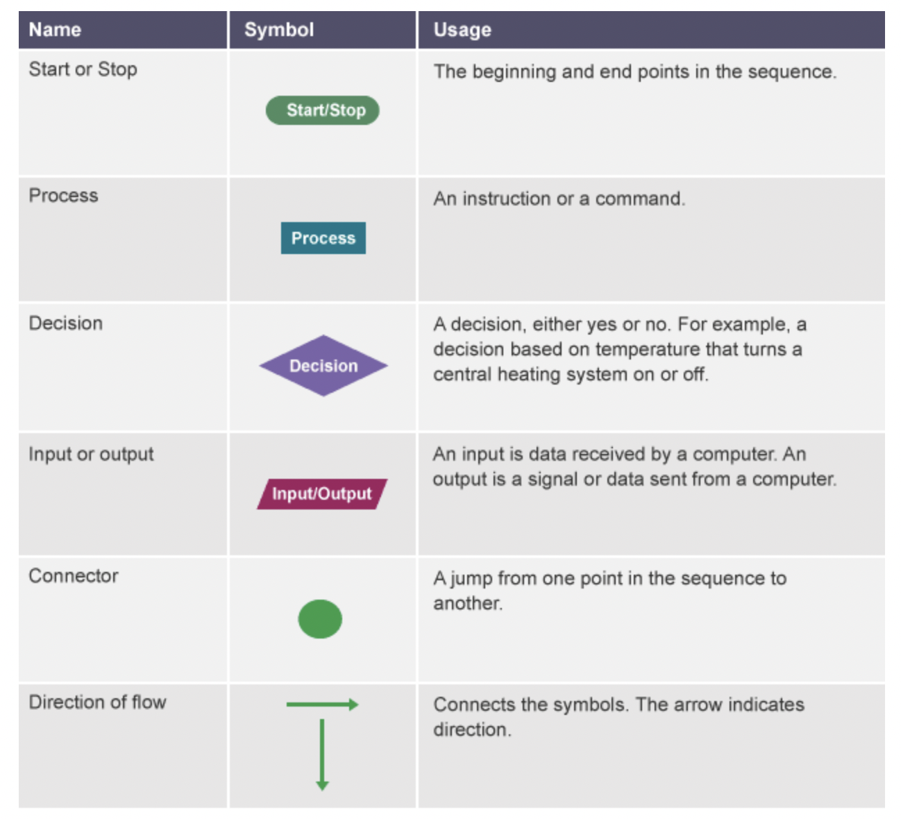

Slide 5
Pseudocode
Writing algorithms in plain English
Why?
Forms a plan for your code
Good way of sharing ideas with people
Important features:
Correct
Understandable
Clear, not ambiguous
Can be implemented onto a computer system
Let’s write some

Slide 6
Syntax, statements and expressions
Syntax = set of rules on how to use a particular language
Failure to follow these results in an error
Statements = a single action in a computer program
Input data, process data, output data
Expression = used to contain values, operators, processes

Slide 7
Programs and data
Computer programs collect and process data
Data that is used in a program is called data values, these influence the sequence of instructions and outputs
They control:
What is done
What is stored
What is transmitted to other devices
What is output to the user
Where can we find data values?:
User input
File, database or other piece of software (pipe)
Sent from another computer or device
Collected from a hardware sensor (camera, microphone)
Generated internally (system clock)
Mouse movements and button clicks, location and timing
These can the be divide into two categories: variable or fixed

Slide 8
Data types
Data is classified into types:
Whole numbers (integers)
Characters
Different types of data are represented in different ways inside a computer (537 and “537”)
Need varying amounts of memory
Differ in operations (give example)
All values represented by the same data type is represented in the same way
The main data types consist of three main hierarchies: numbers, characters or logical

Slide 9
Data type | Example | Size
Integer (whole number) | 4, 27, 65535 | 1 to 8 bytes
Floating point (decimal number) | 4.2, 27.4, 5.63 | 4 to 8 bytes
Character | a, F, 3, $, £, # | 1 byte
String | abc, hello world | Limited to the amount that can be stored in main memory
Boolean | true or false | 1 bit

Slide 10
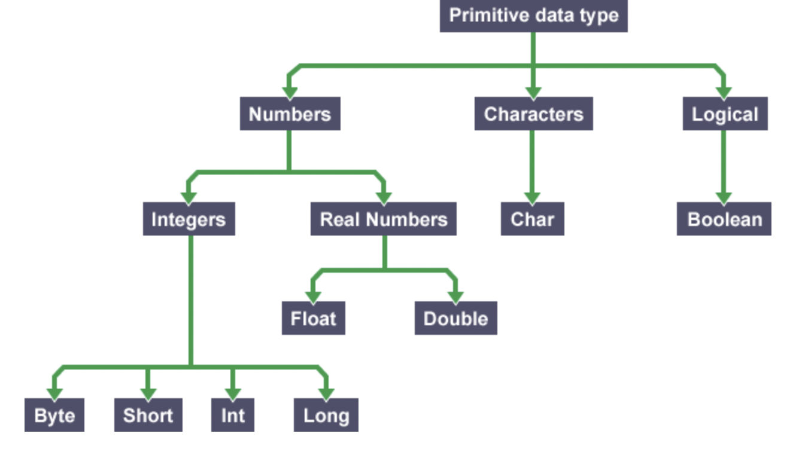

Slide 11
Numbers
Computers work by processing and manipulating numbers
Whole numbers and decimals are represented differently inside the machine
Integers are whole numbers represented as binary values
Floating point numbers have a fractional part, consist of two components:
The main number and fractional parts, each is a binary number
The number data type can affect the type of calculations that can be performed in a program
Adding numbers example 3+3=6(int) but 2.5+3.5=6.0(float)

Slide 12
Characters and strings
Letters, digits and punctuation marks are characters
There are also sets of invisible characters too
\t tab
\n carriage-return (newline)
” “ space
Each value represents a single character from a predefined set such as ASCII or Unicode
Each character has its own binary pattern
String is an ordered sequence of characters
There are also empty strings too (used for unfilled forms)
String can be a constant or variable (keyboard input) – show an example of this
How do we define a string? Quotation marks
A string can be a constant or variable. If it is a constant, it is usually written as a sequence of characters enclosed in single or double quotation marks, ie 'hello' or "hello".

Slide 13
Constants and variables
Variables can be changed by the user or program
Data values are held in memory (what memory is used? RAM)
Constants stay the same every time a program is executed
Literal constants are fixed into source code (Taxi fare rates)
Named constants are values where a name is defined to be used instead of a literal constant (Labelling the rates)
What are some examples?
Variables change when the user is asked a question or during exectution
Variables are a memory location with an associated name
Holds data at that point
What are some examples?
Content and organisation of a computers memory is not fixed and the content of the memory location is copied when the variable is read

Slide 14
Assignment, scope and declaration
To change the data value stored in a variable you use an operation called assignment
This causes the value to be copied into a memory location
Different values may be assigned to a variable at different times during program execution (overwrites)
Equals sign
Scope of a variable can be local or global
Local variables work within a loop, procedure or class they are created in
Global variables can be accessed from any point in a program
Declaring a name for a variable states what the data type will be and where it will be stored in memory
Information about named constants and variables is given by declarations
Sections of program code that define the names that will be used for variables and what kind of data each of them will hold

